Slide 1
Input/Output and Exception Handling
Chapter 11

Slide 2
Exceptions

Slide 3
Exceptions
Two main aspects to exception handling
Reporting
Recovery
Provides a convenient method of passing control from location error encountered to code handling the error
When error encountered, throw the appropriate exception object

Slide 4
Throwing Exceptions
Throw an exception object to signal an exceptional condition has occurred
Example: IllegalArgumentException: Illegal parameter value:
IllegalArgumentException exception
= new IllegalArgumentException(
"Amount exceeds balance"); throw exception;
When an exception is thrown, method terminates immediately
Execution continues with an exception handler

Slide 5
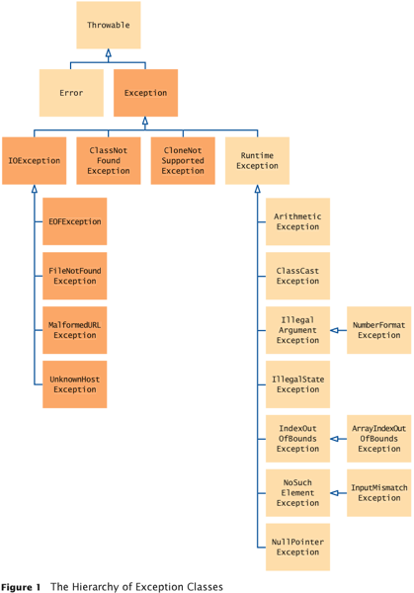
Hierarchy of Exception Classes

Slide 6
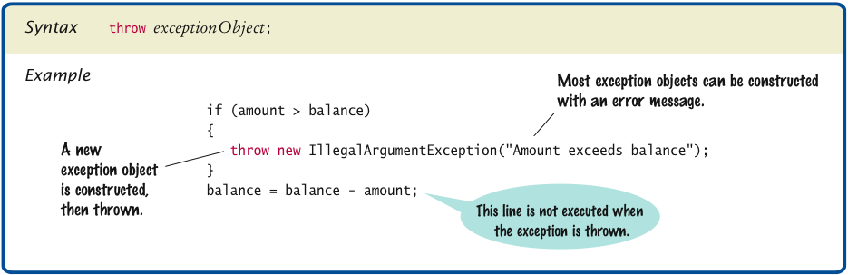
Throwing an Exception

Slide 7
Checked and Unchecked Exceptions
Checked
The compiler ensures you handle the exception
Due to external circumstances that the programmer cannot prevent
Majority occur when dealing with input and output
FileNotFoundException
Extends Exception, FileNotFoundException, ClassNotFoundException or CloneNotSupportedException or their children
Unchecked
Extend the class RuntimeException or Error
They are the programmer’s fault
Examples of runtime exceptions:
NumberFormatException
IllegalArgumentException
NullPointerException

Slide 8
Exception Handling
Two choices
Handle the exception
Let the JVM stop the method and raise the exception
public void method() throws exception
public void method() throws exception1, exception2
Keep inheritance in mind.
If you are throwing an inherited exception and its parent, only need to throws parent.

Slide 9
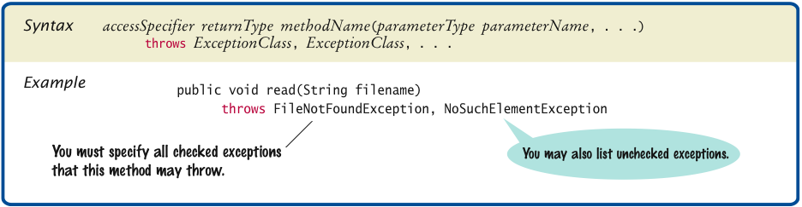
throws Clause

Slide 10
Catching Exceptions
Use a try/catch block to handle exceptions
try block contains statements that may cause an exception
catch clause contains handler for an exception type. Can have more than one catch clause.

Slide 11
Catching Exceptions Example
try
{
String filename = ...;
FileReader reader = new FileReader(filename);
Scanner in = new Scanner(reader);
String input = in.next();
int value = Integer.parseInt(input);
}
catch (IOException exception)
{
exception.printStackTrace();
}
catch (NumberFormatException exception)
{
System.out.println("Input was not a number");
}

Slide 12
Try/Catch
If try block does not throw an exception skip catch block(s)
If exception thrown, corresponding catch block handles it
If no corresponding catch, exception continues to be thrown until handled

Slide 13
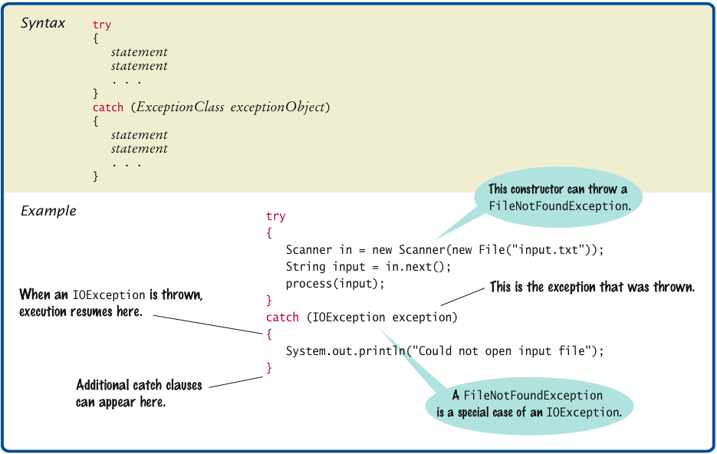
Catching Exceptions

Slide 14
finally block
Use finally clause for code that must be executed “no matter what”
Exception terminates the method so critical code may not be executed

Slide 15
finally examples
FileReader reader = new FileReader(filename); try { Scanner in = new Scanner(reader); readData(in); } finally { reader.close();
// if an exception occurs, finally clause // is also executed before exception
// is passed to its handler }

Slide 16
finally block
Executed when try block is exited in any of three ways:
After last statement of try block
After last statement of catch clause, if this try block caught an exception
When an exception was thrown in try block and not caught

Slide 17
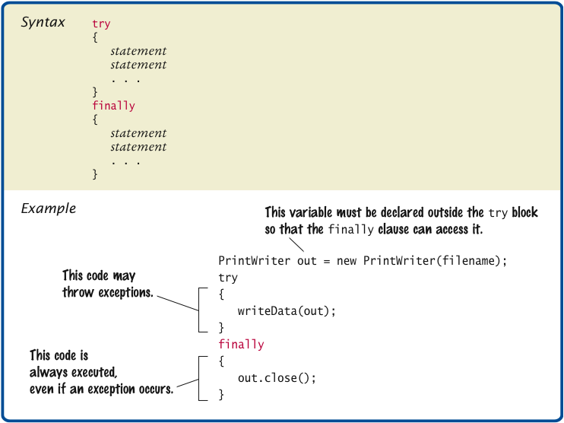
finally Clause

Slide 18
Designing exceptions
You can design your own exception types
subclasses Exception or RuntimeException
Make it an unchecked exception — programmer could have avoided it by calling getBalance first
Extend RuntimeException or one of its subclasses
Supply two constructors
No argument constructor
A constructor that accepts a message string describing reason for exception

Slide 19
Own exception example
public class InsufficientFundsException extends RuntimeException { public InsufficientFundsException() {} public InsufficientFundsException(String message) { super(message); } }

Slide 20
File Handling

Slide 21
Reading Text Files
Simplest way to read text: Use Scanner class
To read from a disk file, construct a FileReader
Then, use the FileReader to construct a Scanner object
FileReader reader = new FileReader("input.txt");
Scanner in = new Scanner(reader);
Use the Scanner methods to read data from file
next, nextLine, nextInt, and nextDouble

Slide 22
FileReader
java.io
Class FileReader
java.lang.Object
java.io.Reader
java.io.InputStreamReader
java.io.FileReader
public class FileReader extends InputStreamReader
Convenience class for reading character files. The constructors of this class assume that the default character encoding and the default byte-buffer size are appropriate. To specify these values yourself, construct an InputStreamReader on a FileInputStream. FileReader is meant for reading streams of characters. For reading streams of raw bytes, consider using a FileInputStream.

Slide 23
FileReader Constructors
FileReader(File file)
Creates a new FileReader given the File to read from
FileReader(FileDescriptor fd)
Creates a new FileReader given the FileDescriptor to read from
Descriptor represents an open file, open socket, or another source or sink of bytes.
FileReader(String fileName)
Creates a new FileReader given the name of the file to read from

Slide 24
ReadFile.java
import java.io.FileNotFoundException;
import java.io.FileReader;
import java.util.Scanner;
public class ReadFile
{
public static void main(String[] args) throws FileNotFoundException
{
File inFile = new File(”test.txt");
//looks in the current directory for the file
FileReader fr = new FileReader(inFile);
Scanner input = new Scanner(fr);
while (input.hasNextLine())
{
System.out.println(input.nextLine());
}
}
}

Slide 25
Writing Text Files
To write to a file, construct a PrintWriter object:
PrintWriter output = new PrintWriter("output.txt");
If file already exists, it is emptied before the new data are written into it
If file doesn’t exist, an empty file is created
Use print and println to write into a PrintWriter:
output.println(29.95);
output.println(new Rectangle(5, 10, 15, 25));
output.println("Hello, World!");

Slide 26
PrintWriter
public class PrintWriter extends Writer
Prints formatted representations of objects to a text-output stream. This class implements all of the print methods found in PrintStream. It does not contain methods for writing raw bytes, for which a program should use unencoded byte streams.
Unlike the PrintStream class, if automatic flushing is enabled it will be done only when one of the println, printf, or format methods is invoked, rather than whenever a newline character happens to be output. These methods use the platform's own notion of line separator rather than the newline character.
Methods in this class never throw I/O exceptions, although some of its constructors may. The client may inquire as to whether any errors have occurred by invoking checkError().

Slide 27
PrintWriter Constructors
PrintWriter(File file)
Creates a new PrintWriter, without automatic line flushing, with the specified file.
PrintWriter(File file, String csn)
Creates a new PrintWriter, without automatic line flushing, with the specified file and charset.
PrintWriter(OutputStream out)
Creates a new PrintWriter, without automatic line flushing, from an existing OutputStream.
PrintWriter(OutputStream out, boolean autoFlush)
Creates a new PrintWriter from an existing OutputStream.
PrintWriter(String fileName)
Creates a new PrintWriter, without automatic line flushing, with the specified file name.
PrintWriter(String fileName, String csn)
Creates a new PrintWriter, without automatic line flushing, with the specified file name and charset.
PrintWriter(Writer out)
Creates a new PrintWriter, without automatic line flushing.
PrintWriter(Writer out, boolean autoFlush)
Creates a new PrintWriter.

Slide 28
Close files
You must close a file when you are done processing it:
out.close();
Otherwise, not all of the output may be written to the disk file

Slide 29
FileNotFoundException
When the input or output file doesn’t exist, a FileNotFoundException can occur
To handle the exception, label the main method like this:
public static void main(String[] args) throws FileNotFoundException

Slide 30
FileWriter
import java.io.FileNotFoundException;
import java.io.PrintWriter;
public class WriteFile
{
public static void main(String[] args) throws FileNotFoundException
{
PrintWriter pw = new
PrintWriter("C:\\src\\2150\\Examples\\src\\Files\\newFile.txt");
pw.println("This is the first line of the text file.");
pw.println("This is the second line.");
pw.close();
System.out.println("File writing complete.");
}
}

Slide 31
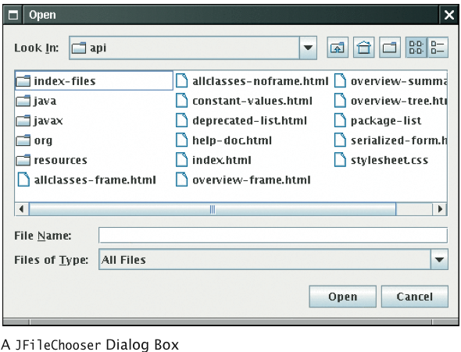
File Chooser Dialog

Slide 32
File Chooser Dialog
JFileChooser chooser = new JFileChooser(); FileReader in = null; if (chooser.showOpenDialog(null) ==
JFileChooser.APPROVE_OPTION) { File selectedFile = chooser.getSelectedFile(); reader = new FileReader(selectedFile); ... }

Slide 33
Reading Words
The next method reads a word at a time:
while (in.hasNext())
{
String input = in.next();
System.out.println(input);
}
With our sample input, the output is:
Mary
had
a
little
lamb
…
A word is any sequence of characters that is not white space
Notes:
A word is any sequence of characters that is not white space. White space includes spaces, tab characters and the newline that separates lines.

Slide 34
Reading Words, Part 2
To specify a pattern for word boundaries, call
Scanner.useDelimiter
Example: discard anything that isn't a letter:
Scanner in = new Scanner(. . .);
in.useDelimiter("[^A-Za-z]+");
...
The notation used for describing the character pattern is called a regular expression
Notes:
useDelimiter – uses regular expression or some other Pattern object to control what the delimiter will be.

Slide 35
Parsing Lines
Then use the isDigit and isWhitespace methods to find out where the name ends and the number starts. E.g. locate the first digit:
int i = 0;
while (!Character.isDigit(line.charAt(i))) { i++; }
Then extract the country name and population:
String countryName = line.substring(0, i);
String population = line.substring(i);
Use trim() to remove spaces at the end of the line
Notes:
isDigit and isWhitespace identify whether character is number or whitespace

Slide 36
Reading Text Input: Processing Lines
Occasionally easier to construct a new Scanner object to read the characters from a string:
Scanner lineScanner = new Scanner(line);
Then you can use lineScanner like any other Scanner object, reading words and numbers:
String countryName = lineScanner.next();
while (!lineScanner.hasNextInt())
{
countryName = countryName + " " + lineScanner.next();
}
int populationValue = lineScanner.nextInt();

Slide 37
Questions?

